Slide 1
Chapter 6
Tailoring Strategy to Fit Specific Industry and Company Situations

Slide 2
Emerging Industry
An emerging industry is an industry that is in the early stages of development. The product, service or technology that the emerging industry is formed around may not be widely known by many people, and therefore may not have an operating system or a strong customer base.

Slide 3
Characteristics of an Emerging Industry
1.Minimal competition
An industry that is in its early stage of development may only consist of a few businesses. As a result, competition among the businesses is minimal.
2.Lots of growth potential
New industries can expand the job market by creating jobs for individuals. If the industry becomes profitable, it can continue to grow and expand. For example, 3D printers and autonomous vehicles are newly-created technologies and are considered one of the latest trends in the technological world that continue to demonstrate growth potential.

Slide 4
3.High risk and high instability Developing a business in an emerging industry is risky if it cannot secure enough funding to cover costs for operations. It is also difficult to find clients or consumers because they are unfamiliar with the new product, which will make them hesitant to purchase or invest in it.
4.High prices due to the absence of economies of scale
Businesses can achieve economies of scale when the efficiency in their production processes allows them to produce more units of a product at a lower price. Businesses in an emerging industry lack economies of scale, as they are still in the process of creating an efficient supply chain and distribution channel.
5.Low barriers to entry
Entry into the market may be easy because there are few competitors. As long as companies possess adequate financial resources and the knowledge to develop a similar product, they will be able to enter the market.

Slide 5
Barriers for Emerging Industries
1.Lack of consumer awareness and consumer loyalty
A vast majority of people do not have awareness of emerging industries, so the companies involved have to invest in a lot of marketing to help potential consumers become familiar with the advantages of the new products or services.
2.Lack of financing
Investors may be reluctant to invest in an industry that is not yet fully developed, as there are larger financial risks associated with these companies..
However, entrepreneurs are gaining access to a growing number of capital sources in recent years. For example, venture capital is a form of private equity financing that is popular for new businesses. Several exchange-traded funds (ETFs) are also established for the purpose of financially supporting emerging industries.

Slide 6
3.Restrictions and regulations
Since the industry is new and unfamiliar, the government may impose restrictions or regulations on business activities. It may prevent businesses from operating efficiently.
4.High costs of research and development.
New businesses may not possess adequate personnel, resources, and knowledge to establish a new product. Therefore, they need to spend a lot on research and development.
5.Lack of suppliers
Depending on what the product is, it may be difficult for suppliers to find sufficient raw materials for businesses to make the product. Therefore, suppliers may be reluctant to work with a business due to the level of difficulty in sourcing the right raw materials.

Slide 7
Potential Strategies for Emerging Industries
1.Low-cost
A low-cost strategy for businesses to gain an advantage in the market by offering low prices in comparison to their competitors. Doing so can increase consumer demand, which can help the business increase revenue.
2.Differentiation
Companies can aim to provide products that are unique and different. It will set them apart from their competitors and gain a competitive advantage.
3.Strategic alliance
Two or more companies can form a partnership to produce a new product together. Instead of being a competitor with each other, companies can work with each other to increase profits.
4.Joint venture
A joint venture involves at least two companies coming together to form a separate business entity to combine assets, resources, and operations. Doing so allows companies to access a bigger market and share financial risks.

Slide 8
What is Industry Life Cycle?
The industry life cycle refers to the life cycle portraying different stages an industry experiences during its life. The four common phases are introduction, growth, maturity, and decline. The industry life cycle represents the different stages in the lifespan of an industry, indicating the emergence, rise, and decline in popularity. There are primarily four stages: introduction, growth, maturity, and decline.

Slide 9
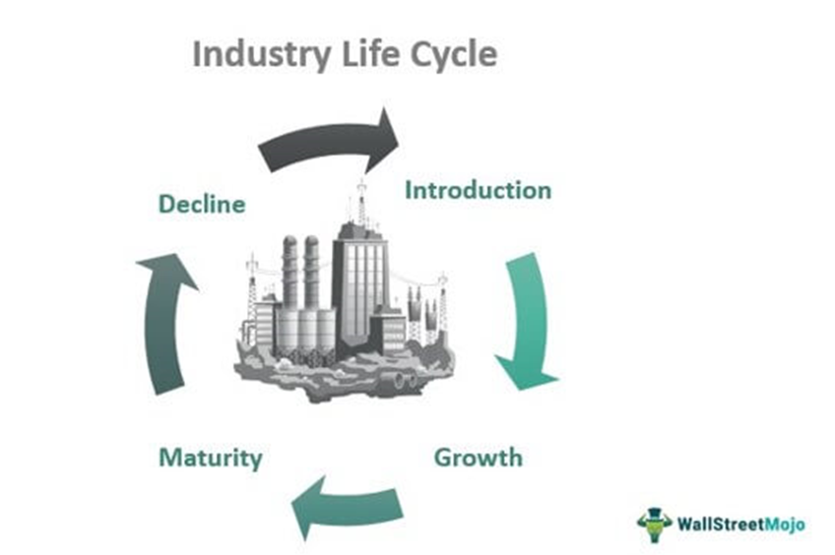
Stages of Industry Life Cycle
The industry life cycle model applies to most industries where businesses experience the four stages of the cycle. The entities enter the cycle when they develop an idea and then traverse the life cycle. Let’s look into the four stages of the life cycle.

Slide 10
1. Introduction
The introduction is the starting phase of the life cycle where a new product, service, idea, or solution to a persistent problem is introduced in the market. Since it is new to the market, the level of demand, sales, and revenue is low, potential consumers are not aware of it, the product may not be a complete version, and requires wide-reaching advertisements. Most of the aspects of the new industry will be in uncertain categories like target market and business model to follow to fit in the industry.

Slide 11
Some of the defining factors that the industry exhibits at its introduction phases are as follows:
Few innovators are creating the industry
Competitors, substitute products, or complementary goods are less
The industry works to reach out to as many people as possible
Marketing and advertising are done aggressively to create awareness
Discounts offers and rewards are given to the product to attract customers.

Slide 12
2.Growth
The second stage of the Industry life cycle is the growth phase. During the growth phase, consumers start to identify and show interest in the industry's offerings. The supply and demand increase. Companies grow organically; they gain and increase market share.
A dynamic environment is not uncommon for the industries during the growth stage. Also, the atmosphere is filled with opportunities, pro activeness specifically in the strategy-making process, is crucial for growth. The companies in the industry now have appropriate business models and process.
Spend of research and development
Producers try to optimize the existing offerings
Focus on organic growth & geographical growth
Complementary and supplementary goods emerge
Investment increases
Profit starts rising

Slide 13
3.Maturity
The maturity phase follows the growth phase. The focus shifted from growth to increasing the cash flow and revenue through the appropriate strategies. They don’t have to spend on R&D or marketing, but competition is intense at this phase. To confront the competition, firms resort to strategies like mergers and acquisitions, economies of scale, cost reduction, competitive pricing, etc.

Slide 14
The industry is leading and enjoys maximum profit
Rate of growth slowdown representing the shakeout stage
Intense competitive pressure and resources are constrained
Dominant designs or improvisations occurs, adding more stress to compete
Competitively aggressive firms exhibit high performance

Slide 15
Decline
After experiencing growth and maturity, the industry moves to a declining phase. At this phase, many companies in the industry face difficulty surviving or prolonging the successful period due to no growth and intense competition. Therefore, they have to find strategies apt for the phase to sustain.
The weaker competitors are forced out of the market
May witness a steep fall in income
The negative impact of factors like market competition, substitutes, consumer behavior, consumer psychology signifies
The decline phase can be delayed using rebranding techniques, large-scale improvements, and attractive rewards

